Slide 1
Sustainable Power
India-Africa Partnership

Slide 2
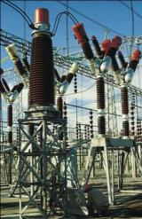
Sterling and Wilson - Verticals
MEP Services
ELECTRICAL
HVAC
PLUMBING
FIRE FIGHING
LV SYSTEM
Power Solutions
EPC Services
O & M
Data Center
DG SET
CO- GEN
SOLAR
EHV & EBOP

Slide 3
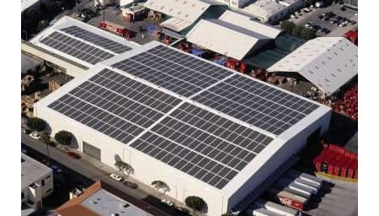
RENEWABLE ENERGY : Solar Offering
Turnkey EPC
Roof Top and Off Grid
Hybrid Solutions
400 MW Solar PV Plants Commissioned/ Under Construction
90 MWp in South Africa
15*20 KWp on Oil Field in Rajasthan
30 KW in Residential building
5 KW on Super Market
10 KW in Food Chain
800 KW in Dubai (under development)
India ranked 1 & Global ranked 20
Solar EPC in 2013

Slide 4
Solar offering: Outcome
Balance of System: Value Engineering
Per MW | 2011 | 2014
Steel , Structures | 85-100 Tons | 45-50 Tons
Cement | 230-270 Cum | 100-130 Cum
Inverters | 20-25% reduction in capacities
Transformers | 20-25% reduction in capacities
Execution Time (5 MW) | 6 Months | 3 Months
Over all Capex Reduction | Base | 30%!
Notes:
Structures → Shadow and Wind tunnel effect
Inverters and Transformer → Optimizations based on generation pattern from Solar

Slide 5
Africa Power Scenario Vis a Vis India
 | India | Africa
Installed Capacity | 211 GW | 147 GW
Per Capita | 778 KWHr | 153 KWHr*
Non Access | 33%** | 77%*
Losses | 30% + | 25%
*Excluding South Africa
** Rural
Notes:
CEA – Monthly Highlights of Power Sector – July,2012
CEA – Monthly Highlights of Power Sector – July,2012
http://powermin.nic.in/JSP_SERVLETS/internal.jsp
http://en.wikipedia.org/wiki/Electricity_sector_in_India

Slide 6
Africa Power Scenario: Proposed Solution
Thrust on Renewables especially Solar
Huge Potential 6,567 TWHr!!!
Near to equator - High Radiation Zones
GHI 2000+ KWHr per Annum
Centralized and Decentralized Generation options
Good Match for Peaking Loads
Solar DG Hybrid Solutions

Slide 7
Diesel + PV Hybrid Solution: Schematic
Diesel Gen-Set
Solar PV Module
Inverter Station
Inverter/Transformer/HT Panel etc.
AMF Panel
Fuel Saver
Compact Sub-Station
Load
11/33KV

Slide 8
Diesel + PV Hybrid Solution: Case Study, South Africa
System Parameters
Installed DG | 6*1550 KVA
Solar PV | 3000 KWp
Solar PLF Generation | 19%
Fuel Saver Controller | Technology Provider: Sterling and Wilson
Diesel Cost | Technology Provider: Sterling and Wilson
Diesel Saved | 45,96,589
System Payback | 3.5 years
CO2 Emission Avoided | 4500 Tons per Year

